Slide 1
BVRIT HYDERABAD College of Engineering for Women
Department Of Information Technology
SMART STREET LIGHT USING IOT
Team – 7
V Sai Akshita – 19WH1A1212
Under the Guidance of
Guide Name : Mr. R. Arun Kumar Designation : Assistant Professor
Athiya Fathima – 19WH1A1232 Priyanka Kolli – 19WH1A1236
M. Preethi –19WH1A1259

Slide 2
Contents
Abstract
Introduction
Problem Definition
Literature Survey
Proposed System
Project Modules
Implementation and Results
Performance Measures
Conclusion
References

Slide 3
Abstract
Smart Street light is an automated system which automates the street.
The main aim of Smart Street light is to reduce the power consumption when there are no vehicle movements on the road.
The Smart street light will glow with high intensity when there are vehicles on the road otherwise the lights will remain dim.
The Smart street light provides a solution for energy saving which is achieved by sensing an approaching vehicle using the IR sensors.

Slide 4
Introduction
Automation plays very important role in the world economy and in daily life. Automatic systems are being preferred over any kind of manual system.
It highlights the energy efficient system of the street lights system using LED lamps with IR sensor interface for controlling and managing.
A LDR Sensor, Photo resistors, Arduino Uno, LED , Resistors are core requirements used in the implementation of the project.

Slide 5
Problem Definition
Conventional street lighting systems use constant illumination lighting which leads to high energy consumption which accounts for most of the municipal government’s total electricity expenditure. Many urban areas are currently facing high carbon emissions due to public lighting, which are a known contributor to climate change. Furthermore, forecasts show that the energy spending for street lights is likely to increase over the next few years as the demand and price for electricity increase.

Slide 6
Literature Survey
Author | Published | Features
S. Rakshan Raj, J.A Marina Chirstina | 2021 | LDR Sensor, Wi-Fi Module
Dr. A. Senthil Kumar, K. Vignesh | 2020 | ZigBee Based Remote Control
Sindhu A. M, Jerin George | 2019 | PC Micro Controller
Raunak Paul1, Attreyee Mandal2 | 2018 | LED Replaces with HID Lamps to include Dimming Feature

Slide 7
Proposed System
Our proposed design aims to reduce the carbon footprint and the overall costs of street lighting by integrating dimmable light-emitting diodes (LEDs) and wireless technology. The principle of operation is to efficiently control the intensity of the streetlights to respond to the needs of road users.
There are two sensors are used which are Light Dependent Resistor (LDR) to point a day/night time and therefore the Infrared (IR) sensor to detect the movement on the road.

Slide 8
Modules
Light Detection Module
Object Detection Module
Power Saving Module

Slide 9
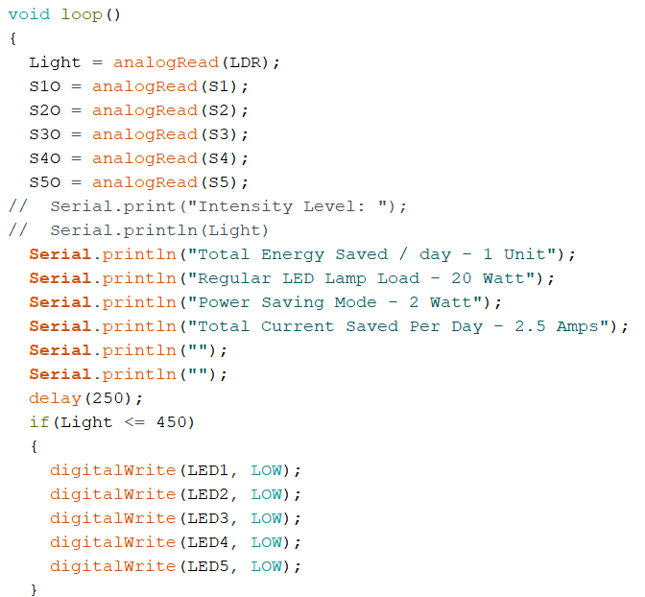

Implementation and Results
Department Of Information Technology

Slide 10
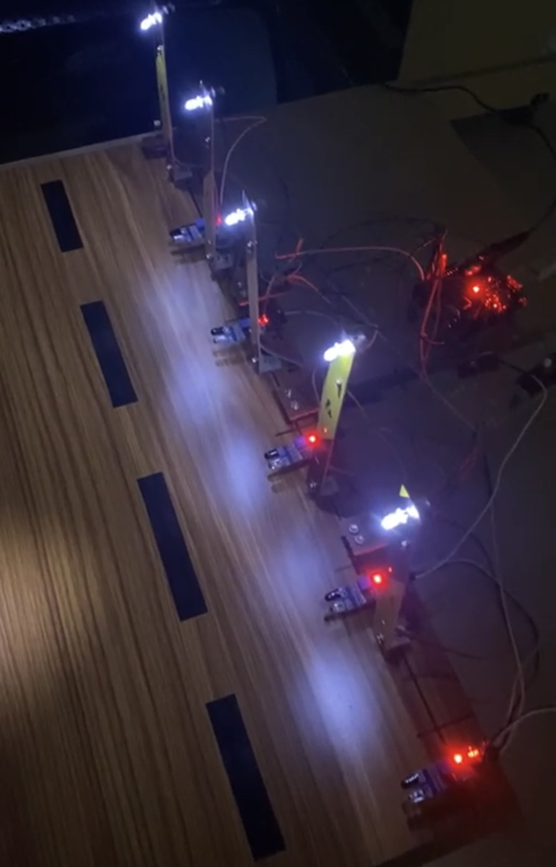
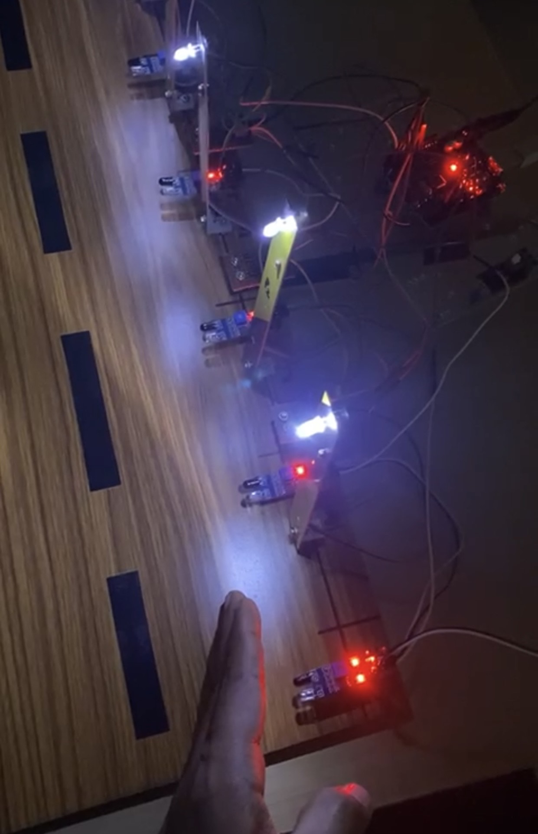
Implementation and Results
Department Of Information Technology

Slide 11
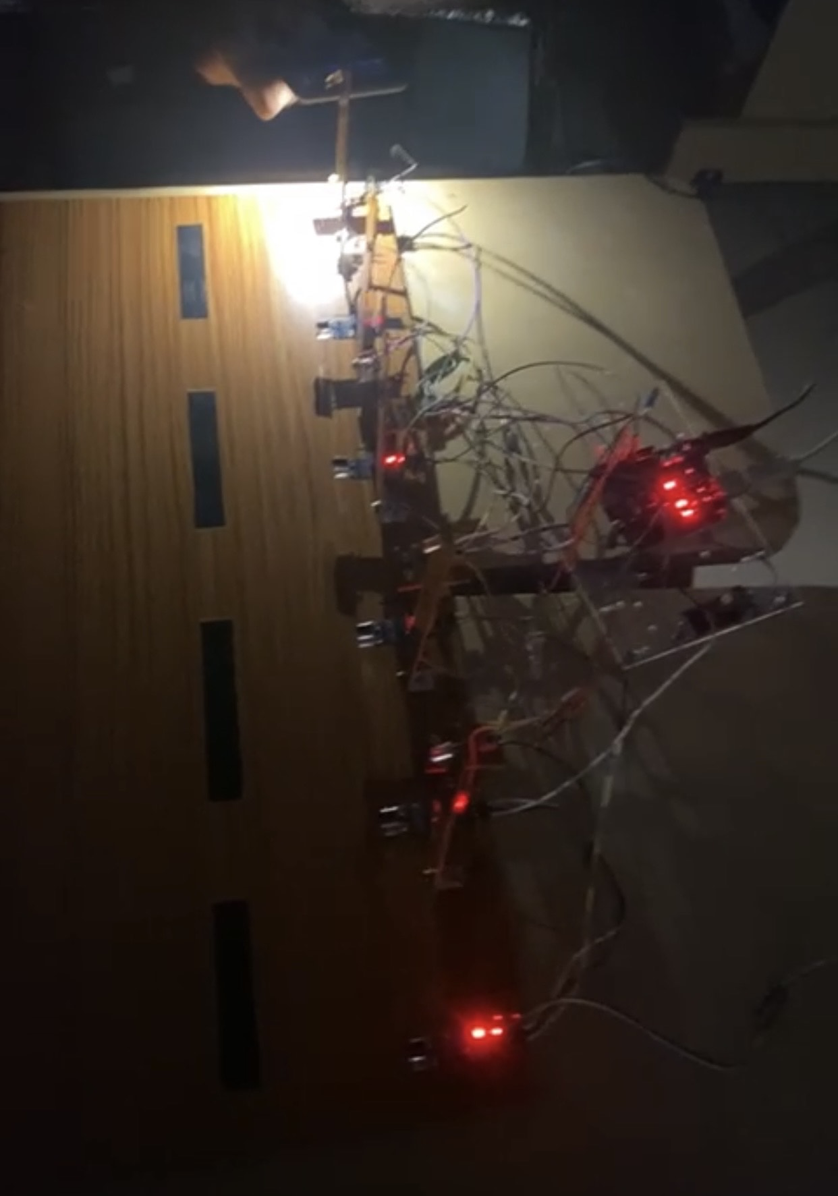
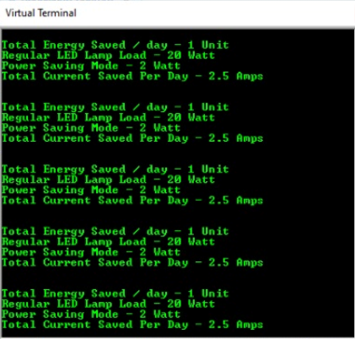
Implementation and Results
Department Of Information Technology

Slide 12
Performance Measures
When an object passes near the IR Sensors, the sensors detect the objects and sends the values that are captured to the system. The system processes these values and controls the brightness of the street lights. Since the brightness of the street lights is controlled by the system the output is fast and precise. Therefore resulting in a smaller response time.
As the brightness of the street lights is not constant the power consumption varies, which leads to lower consumption of power when the system is in the power saving mode. This can help lower our expenses related to the consumption of the energy.

Slide 13
Conclusion
By using Smart Street light, we can save surplus amount of energy.
It prevents unnecessary wastage of electricity, caused due to manual switching of streetlights.
It also provides an efficient and smart automatic streetlight control system with the help of IR sensors which can reduce the energy consumption and maintains the cost.
The Smart light system can be further extended to make the current system in traffic, making the system more flexible in case of rainy.
Department Of Information Technology

Slide 14
References
Y M Jagadeesha , S Ak Ilesha , S Karthika , Prasantha, “Intelligent Street Lights “, December 2018,Procedia Technology, 21:547 551,DOI:10. 1016/i.protcy.2018.10.050
Chaitanya K , Shweta D, “ Arduino Based street light system” , February 2019 | IJIRT | Volume 5 Issue 9 | ISSN: 2349-6002.
Dr. A. Senthil Kumar , K. Vignesh, “ Adaptive Lighting in Street Lights ”, International Journal of Engineering Research & Technology (IJERT) ISSN: 2278-0181 Published by, www.ijert.org ECLECTIC - 2020 Conference Proceedings.
Rajeshwar Rao Arabelli , P Anuradha , “ street light management system for conservation of electrical energy “ , IOP Conf. Series: Materials Science and Engineering IOP Publishing doi:10.1088/1757-899X/981/3/032041, 2021.

Slide 15
THANK YOU!!

